Slide 1


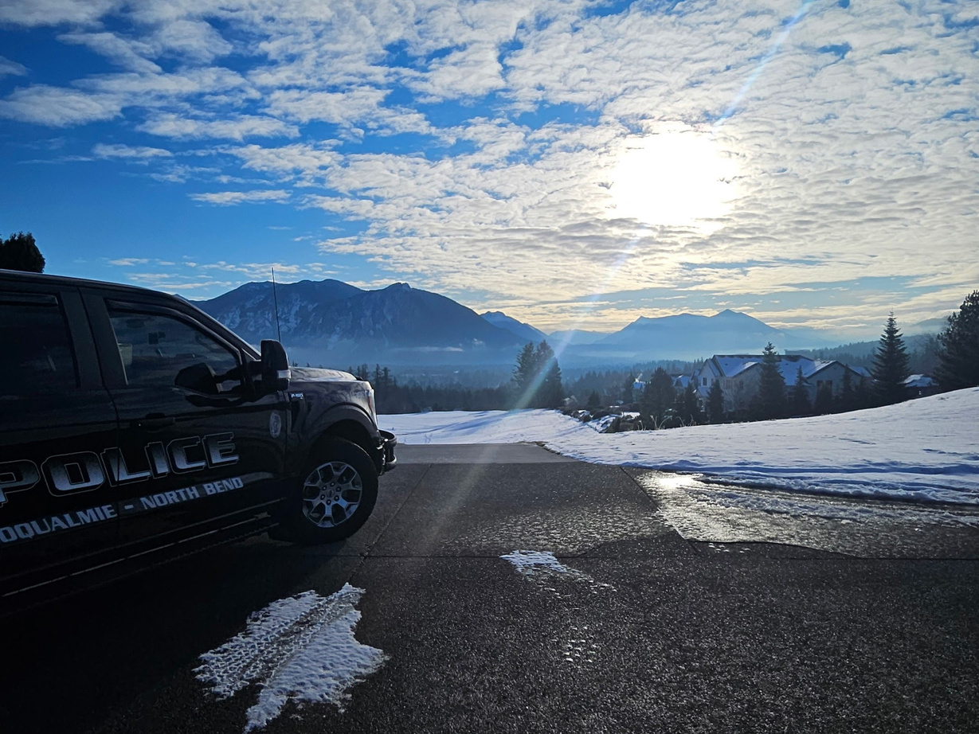
SNOQUALMIE POLICE DEPARTMENT
CONTRACTED POLICE SERVICES PROPOSAL
Presented To
Presented By
North Bend City Council
Gary Horejsi, Police Captain
Drew Bouta, Finance Director

Slide 2

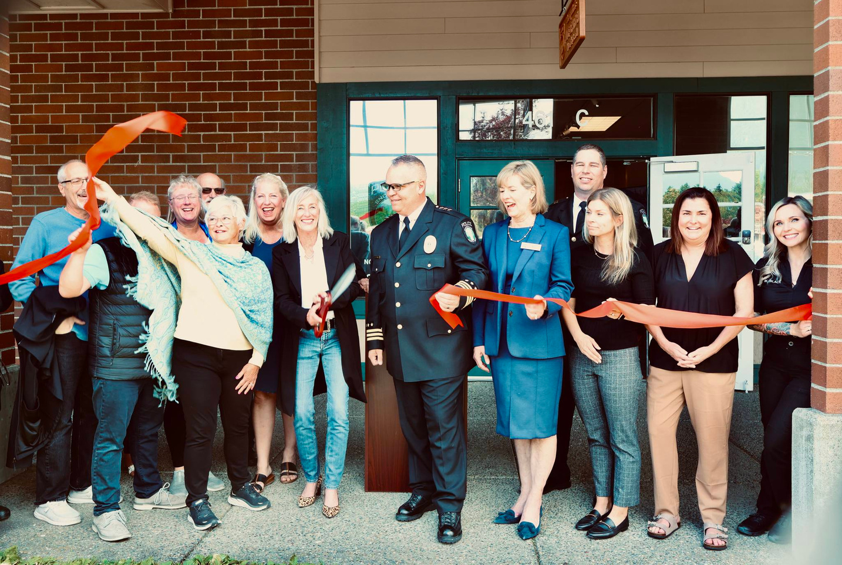
TABLE OF CONTENTS
01
Organization & Proposed Services
02
Contract Experience & Results
03
Response Times
04
Response Capacity
05
Community, Council & Staff
Engagement
06
Cost
07
Contacts

Slide 3

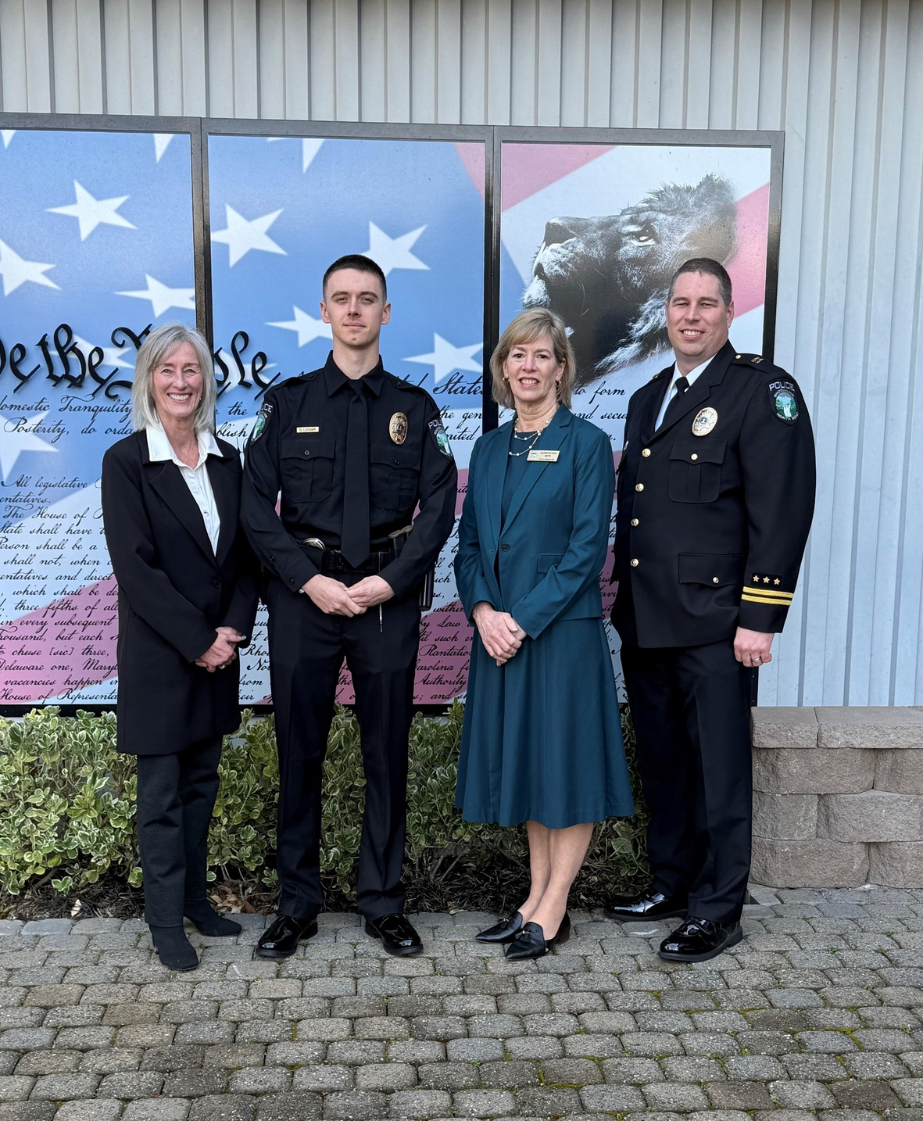
OVERVIEW
The Proposal
The Snoqualmie Police Department has been proudly serving the community of North Bend since March of 2014. Serving both cities has become an integral part of this agency’s identity. Our dedication to ensuring the safety of those who work, visit, and call North Bend home is embodied in the department’s motto:
“No Call Too Small”.
Our Mission Statement
The Snoqualmie Police Department is committed to service, professionalism, teamwork, and making a positive impact at every opportunity.
Two Cities, One Community

Slide 4
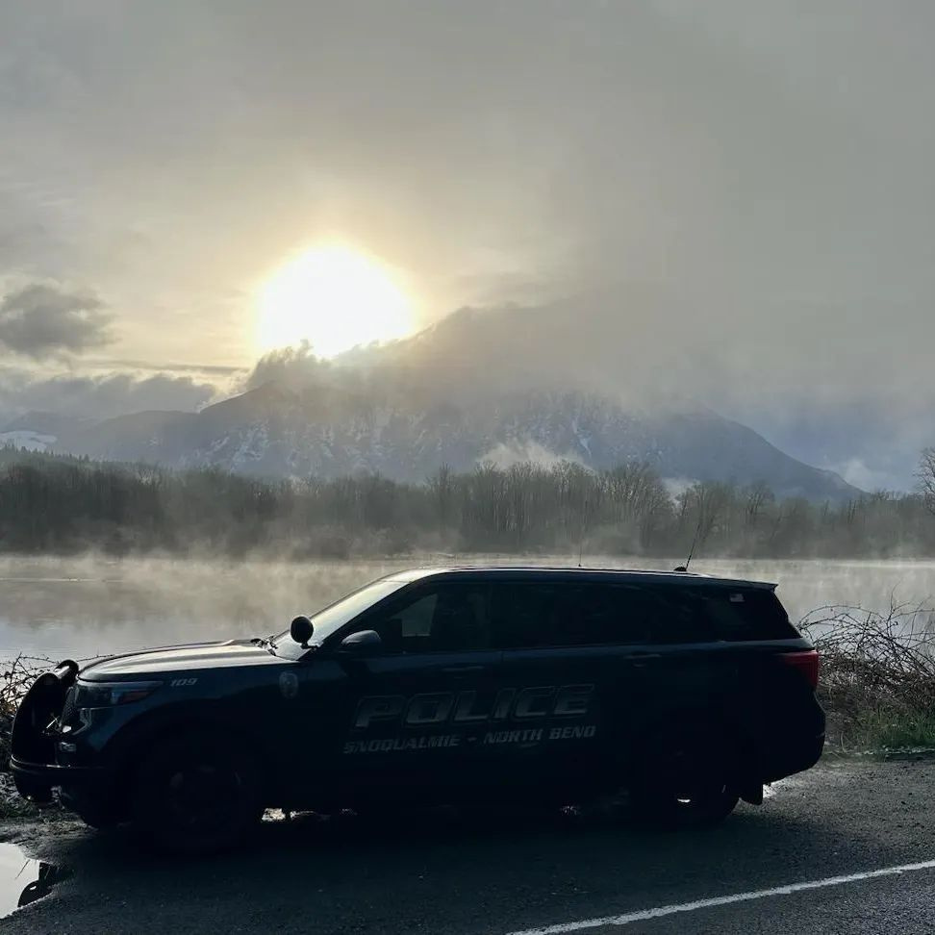



SECTION
1
ORGANIZATION
&
PROPOSED SERVICES

Slide 5

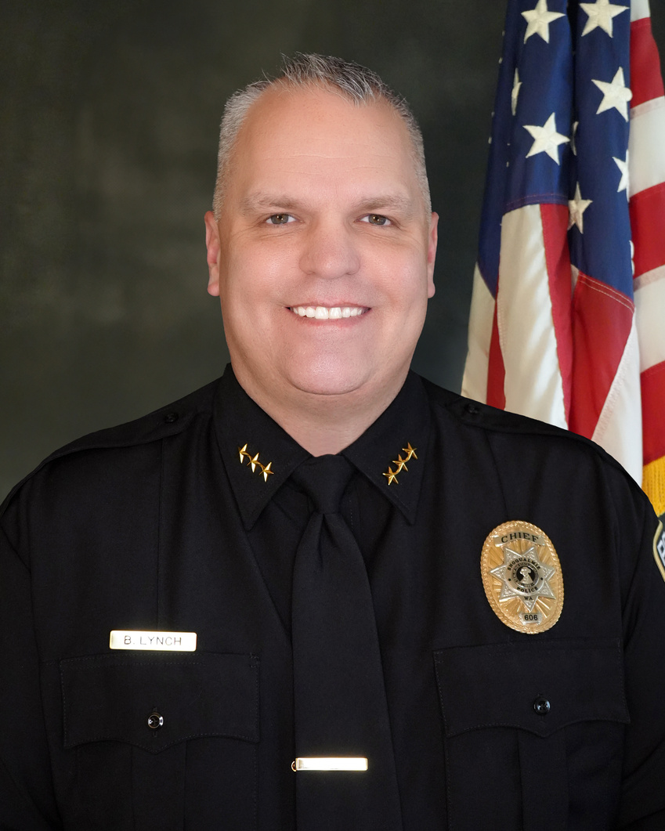
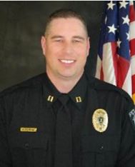



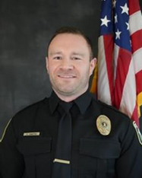
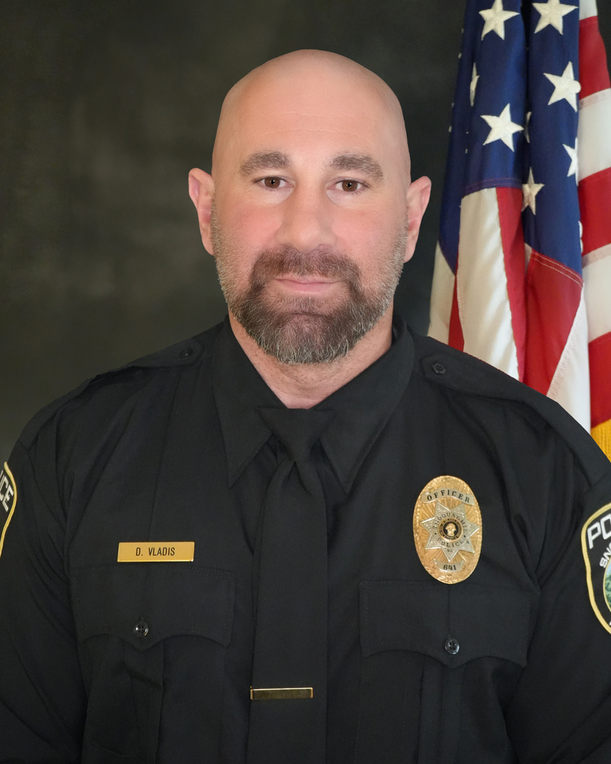

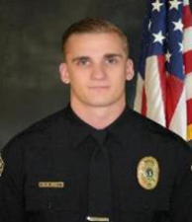
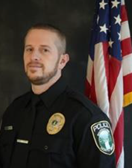
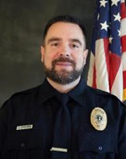

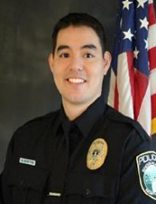

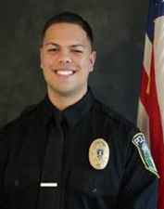
COMMAND STAFF
LEADERSHIP & PATROL TEAM
SERGEANTS
NORTH BEND ASSIGNED OFFICERS
For full biographies, please see the written proposal

Slide 6

DIVISIONS
The Patrol Division provides 24/7 police services to those who call this area home, along with the many visitors who come to our great cities for pleasure or work. The officers respond to all 911 emergency calls, routine calls for service, and conduct proactive policing.
Patrol
The Investigation Unit is responsible for examining all property and economic crimes, violent crimes, and special assault cases. It also works with the Coalition of Small Police Agencies’ Major Crimes Task Force (MCTF) and a number of other partners throughout Washington State.
Investigations
The School Resource Officer works in collaboration with the Snoqualmie Valley School District to investigate crimes involving juveniles and provide support while building relationships with our youth.
School Resource Officer
The Police Support Officer coordinates prisoner transports and has a pivotal role in our community events such as National Night Out and fundraisers for the Snoqualmie Valley Food Bank.
Police Support Officer
Mental Health Professional
The Mental Health Professional is a co-responder with our officers providing services to individuals in crisis, including diversion from detention or arrest, hospitalization, or other resources.
The Administrative Services section supports the criminal justice process in case management, crime reporting, public record requests, court orders, evidence management, and concealed pistol licenses.
Administrative
Services

Slide 7
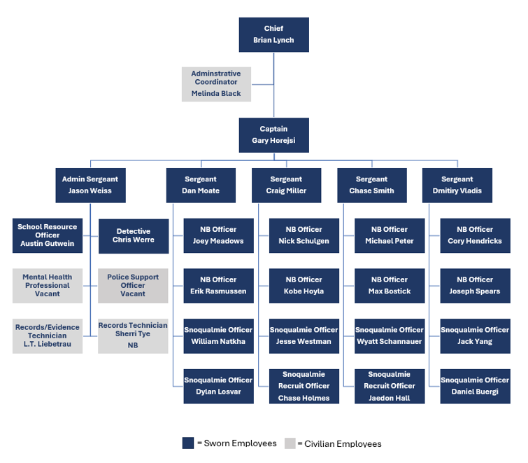
MAP OF THE ORGANIZATION
AVERAGE TENURE OF ALL EMPLOYEES IS
4.5 YEARS

Slide 8
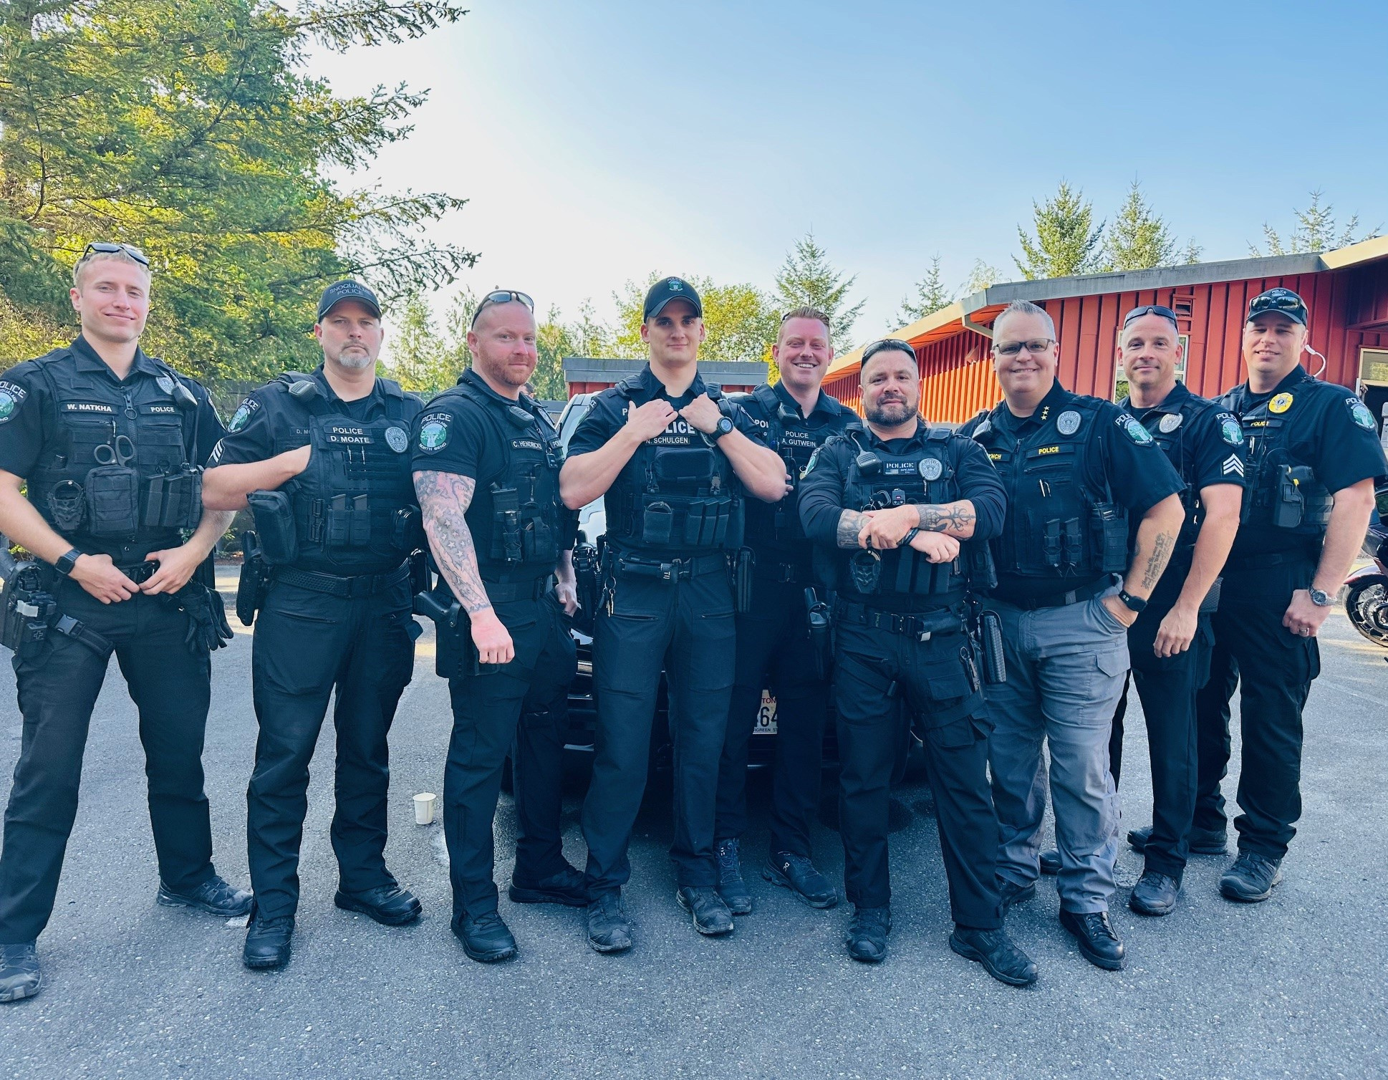
COMMAND & PATROL STAFF TRAINING
Patrol
Officers are required to complete 24 hours of training per calendar year. Typically, annual training includes Crisis Intervention, Emergency Vehicle Operations Course, CPR/First Aid, Data Security, Firearm and Less Lethal Qualifications, etc.
Patrol Supplemental
Our Department provides more than the minimum 24-hour required training, with staff participating in over 80+ hours of training annually. We focus on specialized training that benefits the individual officers, the Department, and the communities we serve.
Command
In addition to the required training of patrol officers, our Command Staff undergo Supervisory, Leadership, Management, and Executive Level trainings.

Slide 9
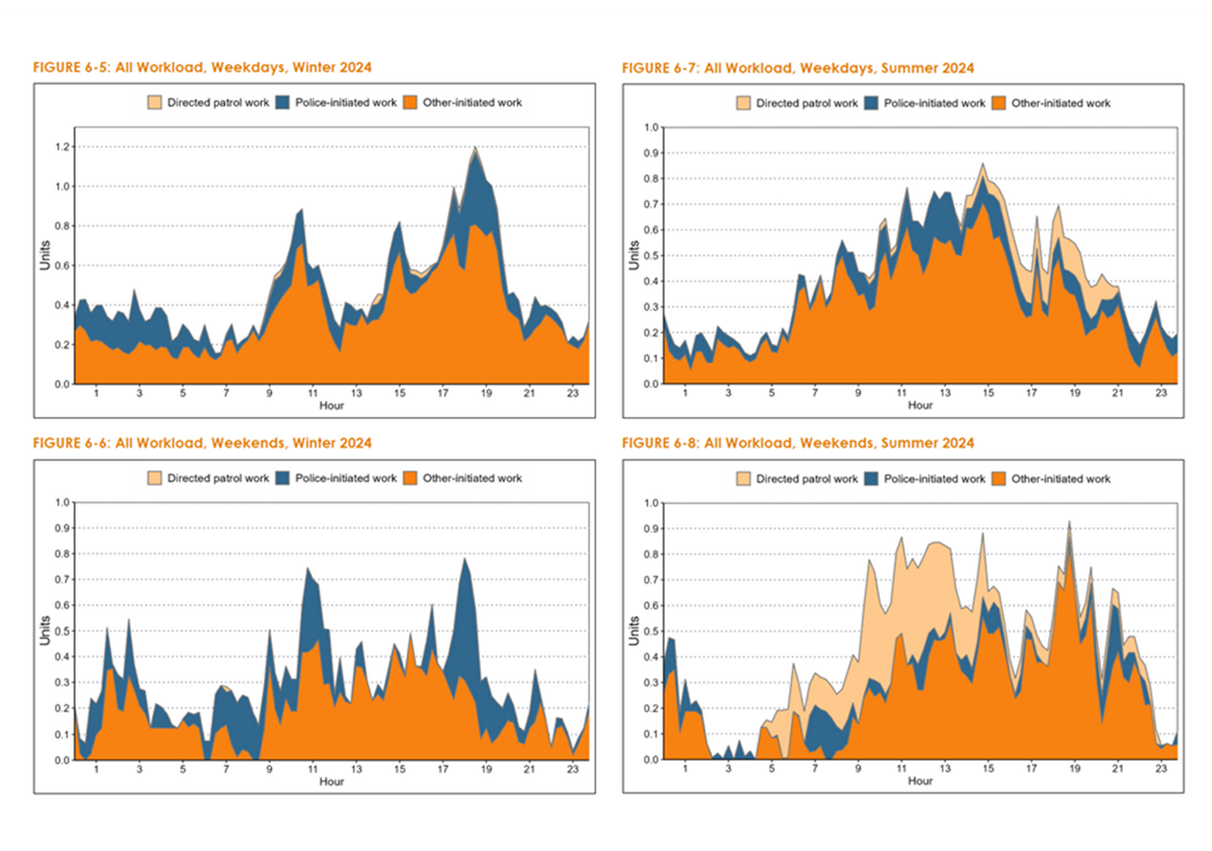
PROPOSED SERVICES
  Easy to Reach, Hard to Leave
    A livable and charming community, where people care about and know each other, requires a police department that shares the same values.
  “No Call Too Small”
    Everyone and every call matters.
  Addressing North Bend’s Unique Policing Needs
    CPSM Report’s Workload Analysis (p. 38-39, 49)

Slide 10



PROPOSED SERVICES
MINIMUM AND PROPOSED COVERAGE
Minimum Sworn Officer Level
Proposed Coverage
Full-Time Employees
  8:00 a.m. to 8:00 p.m.:
    2 NB Officers.
  8:00 p.m. to 8:00 a.m.:
    1 NB Officer.
  6:00 a.m. to 6:00 p.m.:
    2 NB Officers, 2 Snoqualmie Officers, 1 shared Sergeant.
  6:00 p.m. to 6:00 a.m.:
    2 NB Officers, 2 Snoqualmie Officers, 1 shared Sergeant.
Shared positions allocated based on weighted calls for service:
  Police Chief & Captain
  Detective
  School Resource Officer
  Mental Health Professional
  Police Support Officer
  4 Administrative Specialists

Slide 11
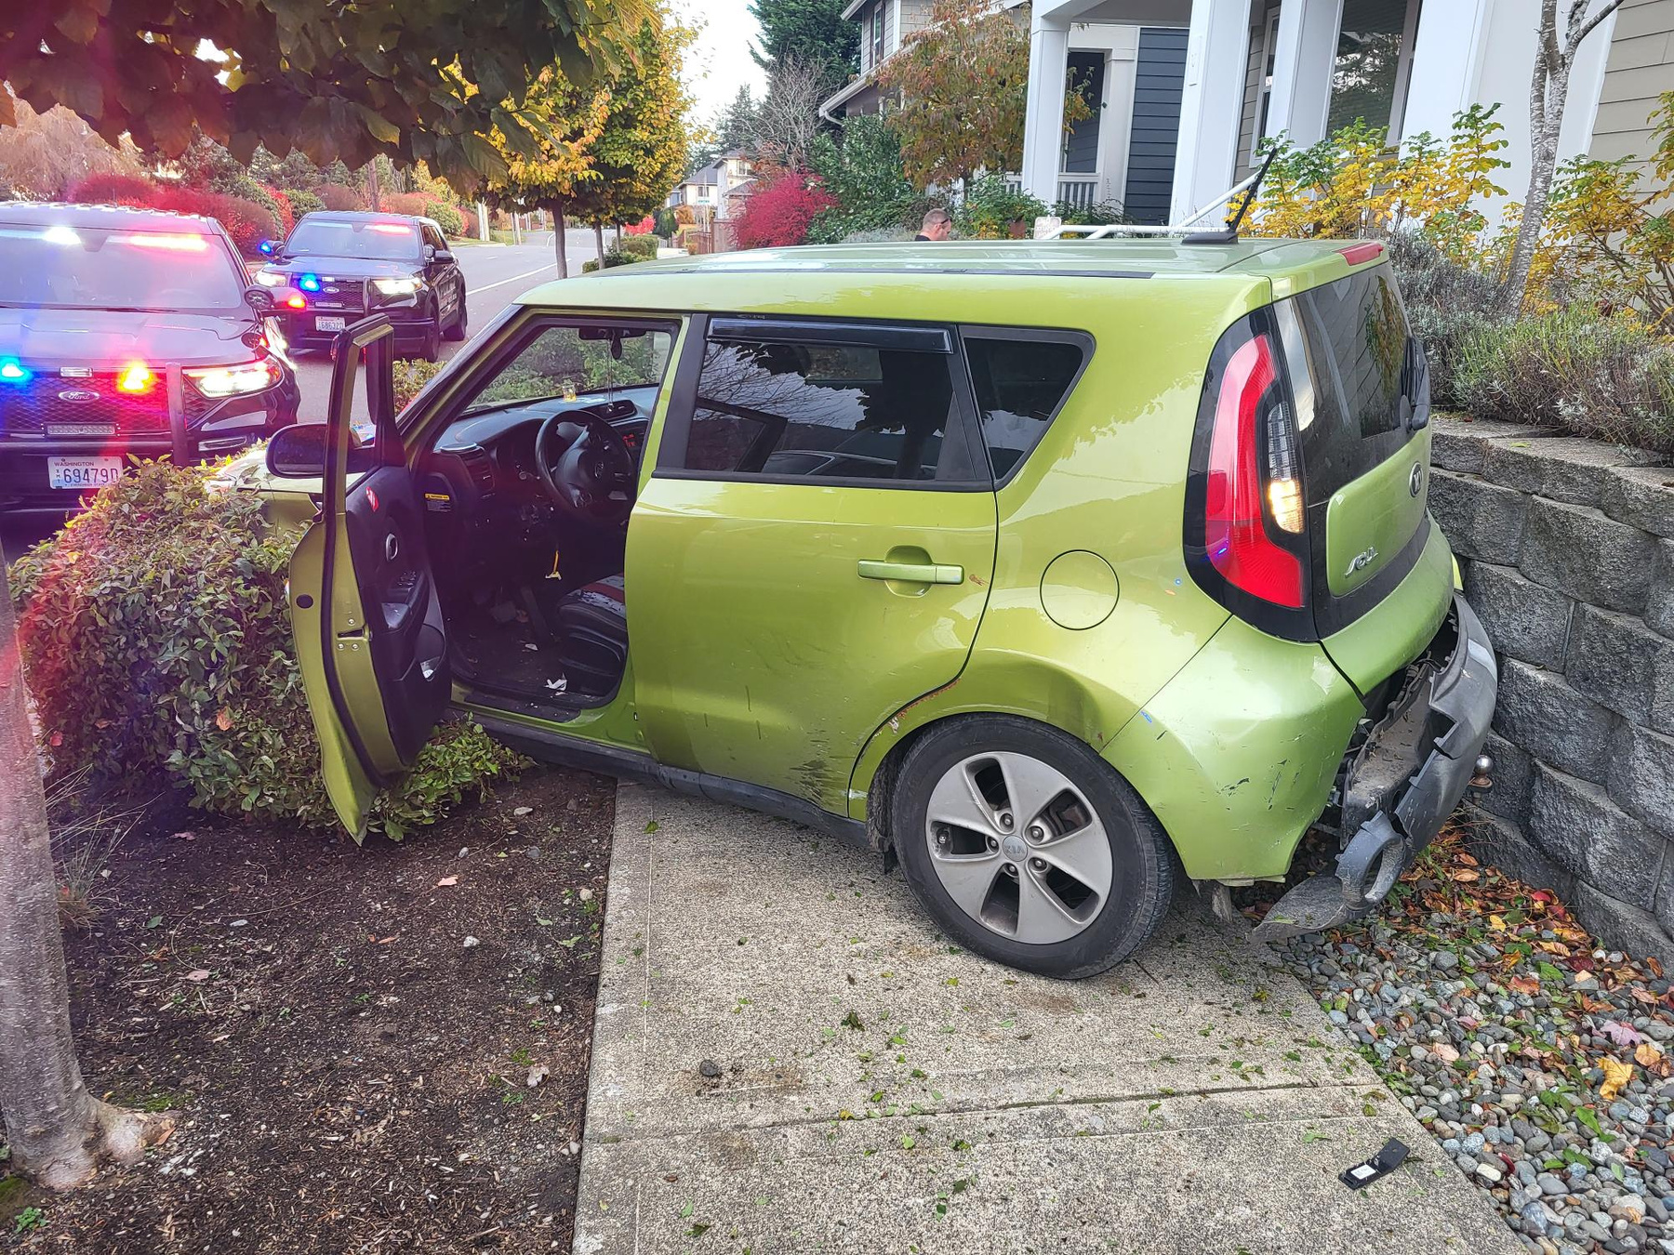


ACTIONS TAKEN
QUALITY SERVICE
OPERATIONS OPTIMIZATION
  Community-Based Policing
  Partnerships: Civic, Business, and Law Enforcement
  Local Engagement and Public Events
  Response to All Calls for Service, “No Call Too Small”
  Continuous Performance Evaluation and Improvement
  LEMAP Assessment
  Staff Training
  Review of Policy and Training Manuals

Slide 12

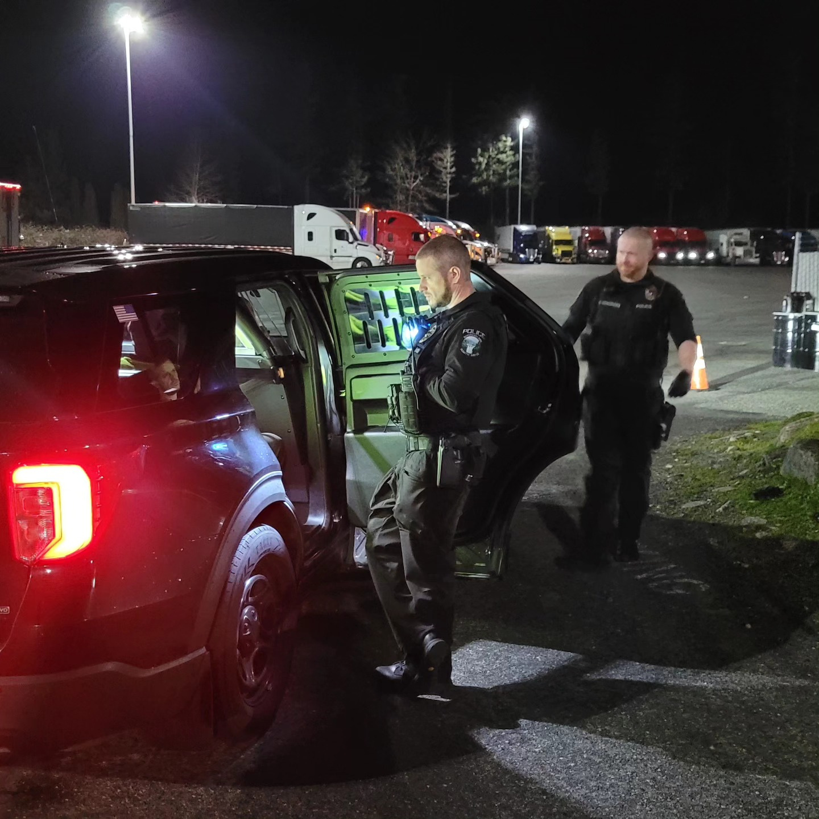

FUTURE INITIATIVES
ACCREDITATION
  Based on LEMAP Report
  Increasing Public Confidence
  Intensify Operational Effectiveness
  Policies and Procedures
  Reduction in Liability
  Improved Agency Morale & Pride
ADDITIONAL ADMINISTRATIVE SPECIALIST
  Accreditation Support
  Workload for Public Record Requests
  State and Federal Crime Statistic Reporting
  Assist with Case Management
  Concealed Pistol Licenses
  Court Orders

Slide 13
SECTION
2
CONTRACT EXPERIENCE

Slide 14
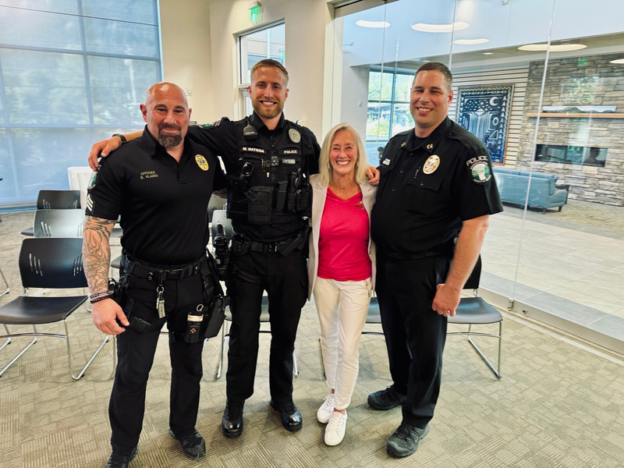
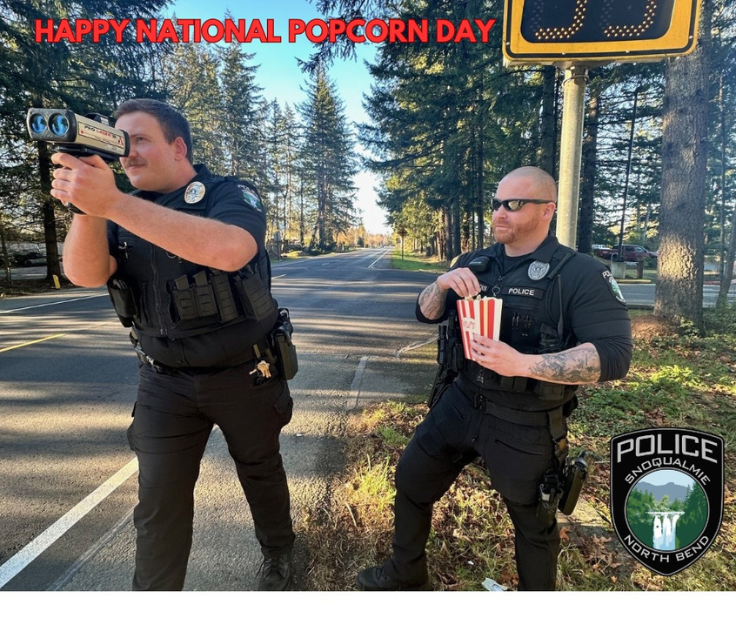
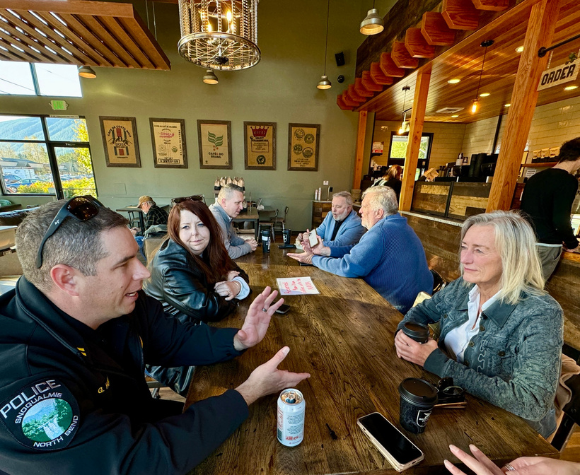
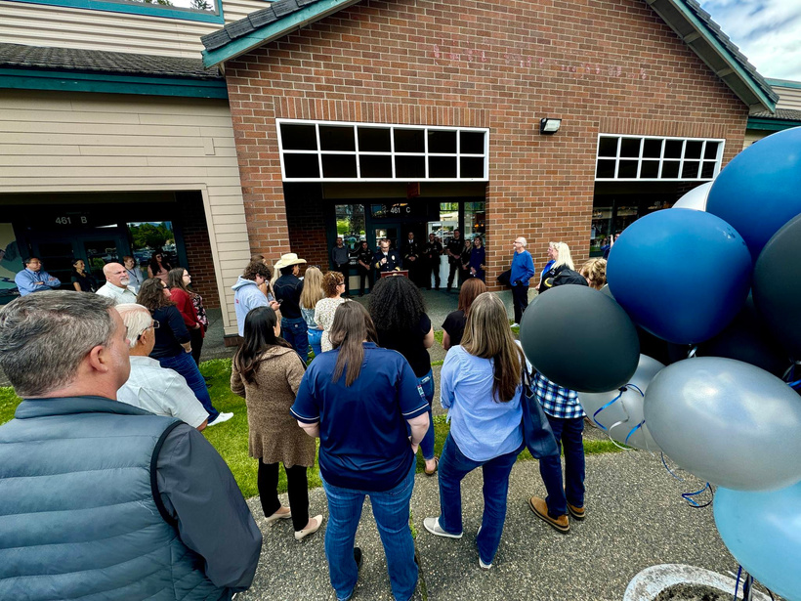
CONTRACT EXPERIENCE
SERVICES AND RELATIONSHIPS
MEETINGS
EXTRA PATROLS
COMMUNITY CONTACTS
OUTLET MALL ANNEX
  Management
  Public Health & Safety Committee
  City Council
  Tanner Electric
  Elk Fields
  U.S. Postal Inspector
  Community events
  Direct contact in the field
  Phone calls
  Emails
  Social media
  In response to retail thefts
  Limited public expense
  Visible presence at commercial base

Slide 15
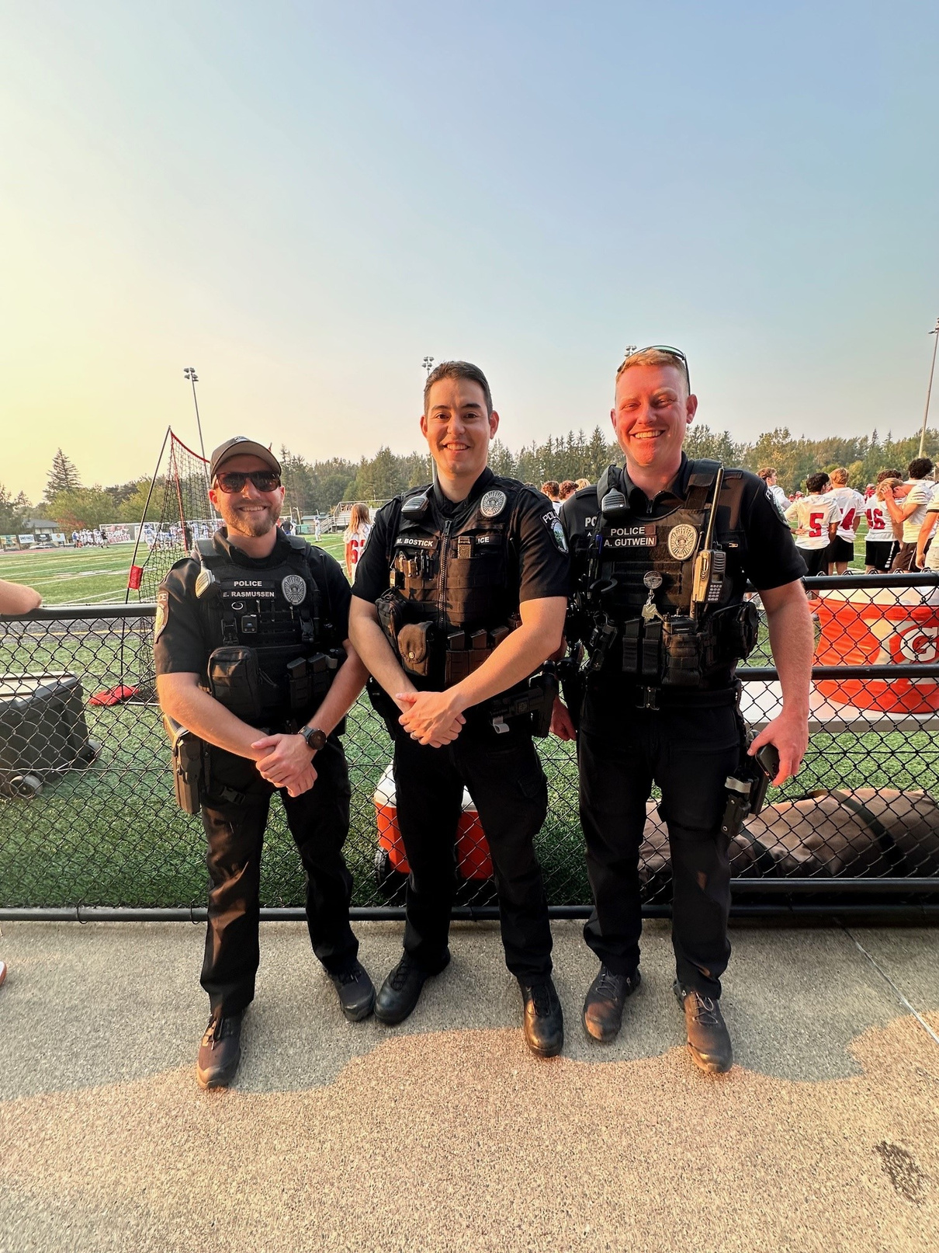



IMPACT
Based on the 2023 City of North Bend Community Survey Rating Satisfaction with SnoPo Police Services
74%
Satisfied
23%
Neutral
3%
Dissatisfied

Slide 16
SECTION
3
RESPONSE TIMES

Slide 17

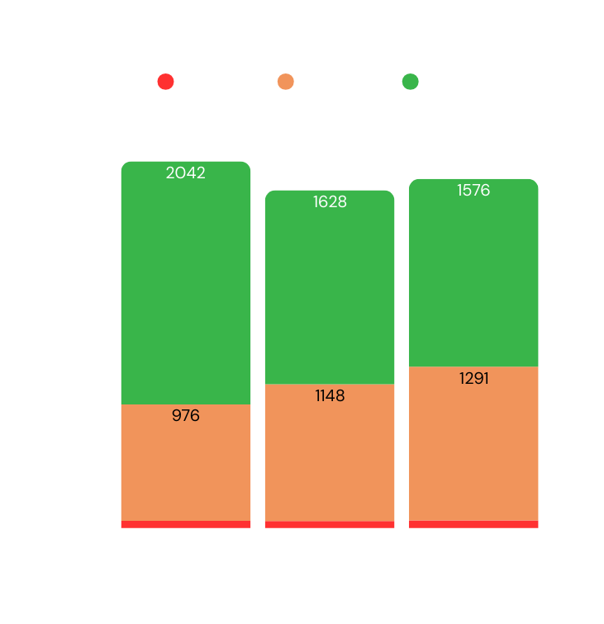
RESPONSE TIMES
62
60
65
  Priority 1: Serious crime with immediate threat to life. Ex: Weapons Offense, Physical Domestic Violence, Assault/Burglary in Progress.
  Priority 2: Calls that involve a serious crime or incident with potential for violence or escalation but not necessarily an immediate threat to life. Ex: Injury Accident, Court Order Violation in Progress, Vehicle Theft/Prowl in Progress.
  Priority 3: High priority but not an immediate threat. Ex: Suspicious, Traffic Hazard, Welfare Check, Harassment.

Slide 18
SECTION
4
RESPONSE CAPACITY

Slide 19
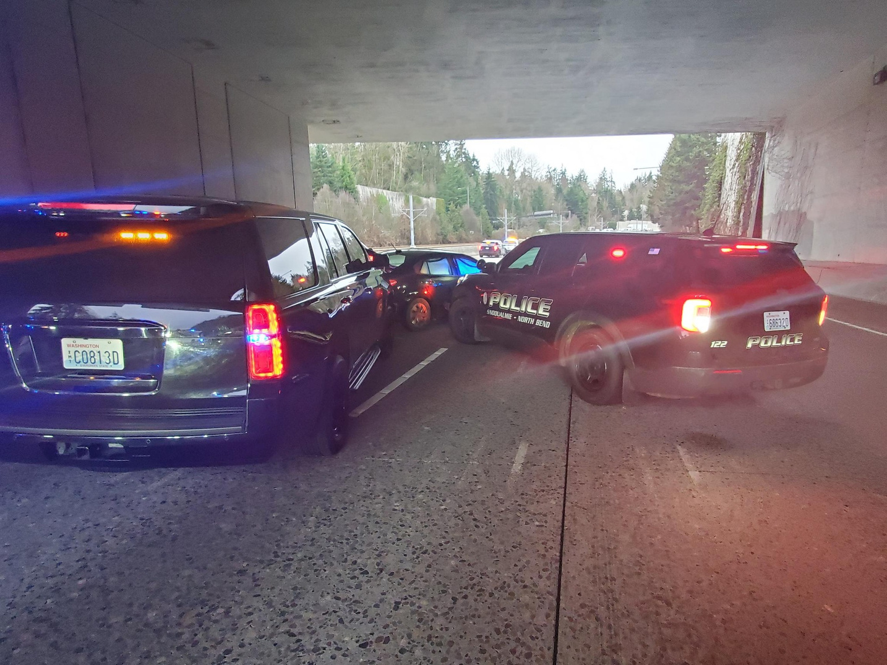
RESOURCES
MHP
MCTF
AIR
Mental Health
Co-Responder
In House
Major Crimes Task
Force
Guardian One - KC
Smokey - WSP
Drone - Issaquah PD
K9
SWAT
SAR
Tracking / Drug Dog
Bellevue PD, Redmond PD, WSP
TAC 30 - KC
Valley SWAT
Search & Rescue - KC
Seattle Mountain Rescue
MEDIA
WSP
LAB
Public Information Officer & Communications Dept.
Bomb Squad
Major Collision Investigation
Crime Lab - WSP
Toxicology Lab - WSP
AFIS - KC

Slide 20
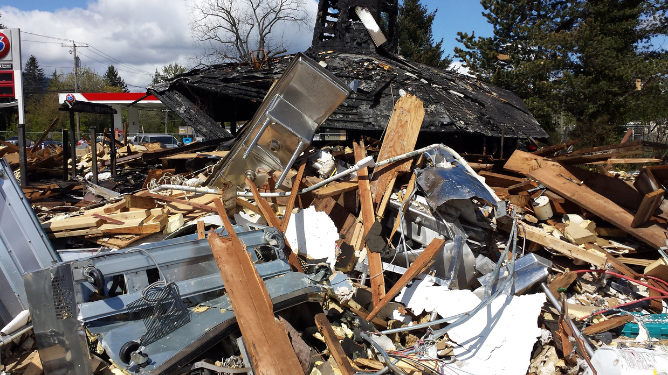

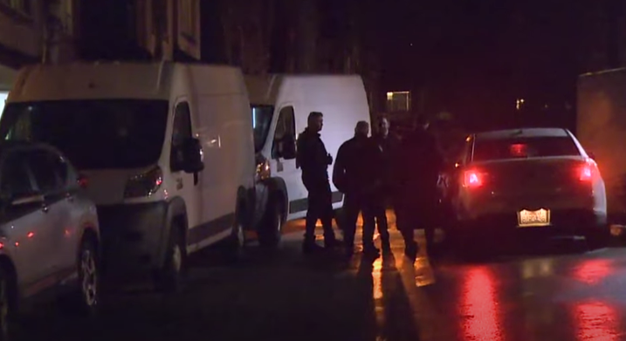
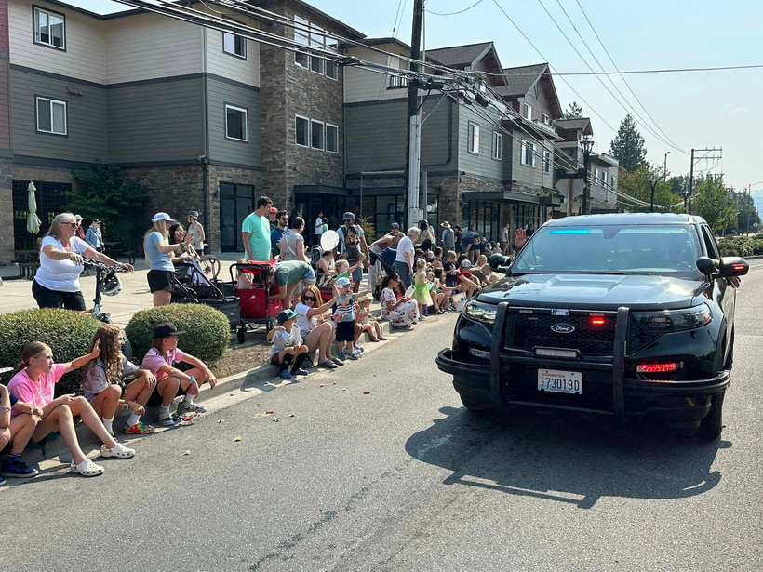
RESPONSE CAPACITY
  Pursuit
  WSP, KCSO, Issaquah PD, Bellevue PD, Guardian One
Natural Gas Explosion
April 25, 2014
Sno Falls Credit Union Robbery
  Proximity to Gas Station
  Door-to-Door Searches
  Evac vs. Shelter-in-Place
  Large Scale Locs: Apt Complex, Nursing Home
January 26, 2024
  CSPA, WSP
  Operations Plan: Risk and Intelligence Assessment, Traffic, Communications
  Day-Of Security and Law Enforcement
Homicide / Suicide
January 31, 2024
Boeing Classic & Festival at Mt Si
Annually
  KCMEO, MCTF, WSP Crime Lab, ATF

Slide 21
SECTION
5
COMMUNITY, COUNCIL & STAFF ENGAGEMENT

Slide 22


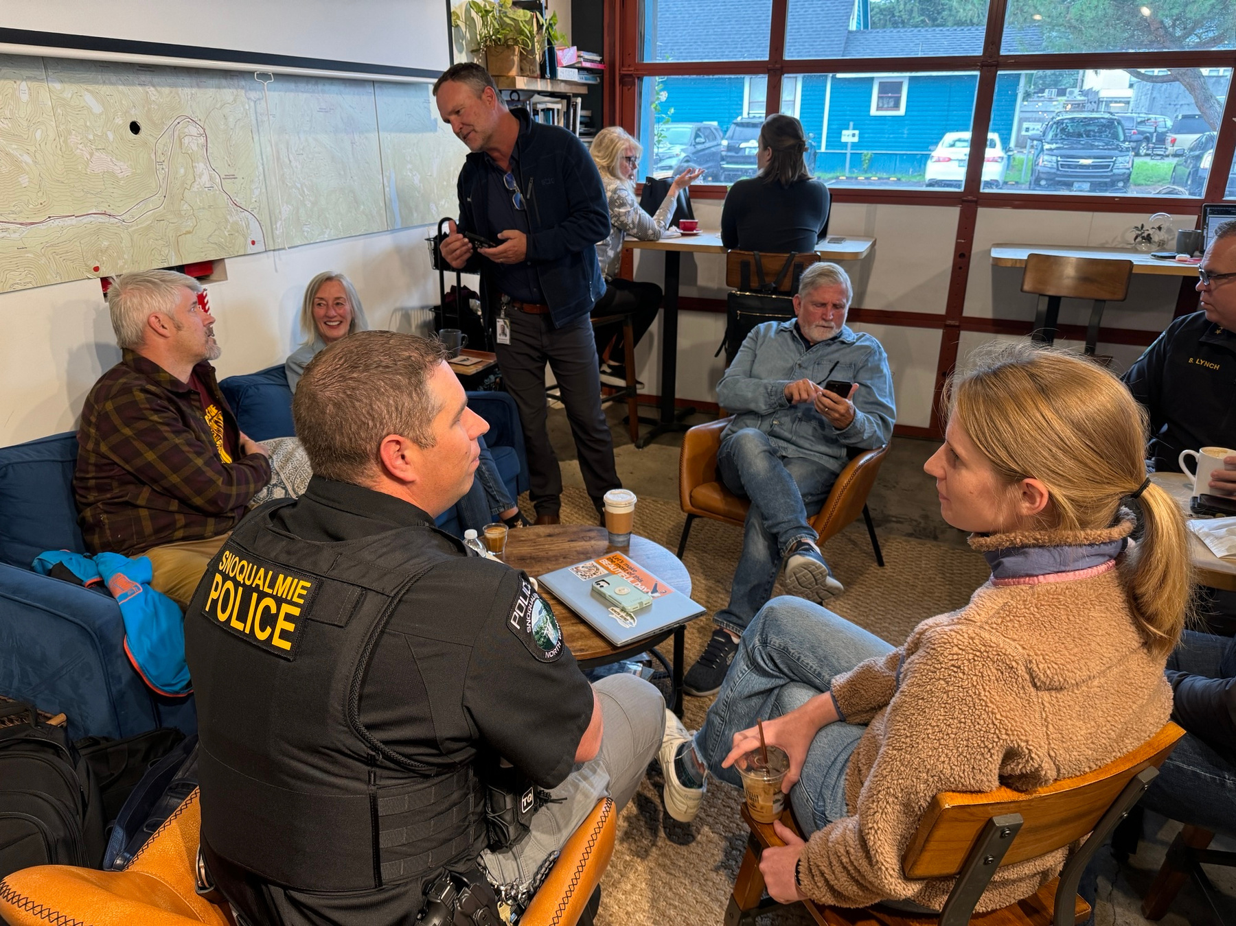

COMMUNITY EVENTS
The Snoqualmie/North Bend Police Department recognizes the importance of community engagement and upholds the principles of community policing. We regularly participate in several events, including:
We are committed to fostering a cohesive and supportive environment by prioritizing a visible presence, cultivating strong relationships with residents, and encouraging collaborative partnerships with local businesses and organizations.
North Bend Block Party
Citizens Academy
Festival at Mount Si
Chat with the Chief
National Night Out
Fishing Derby
Red, White, and Boom
Safe Rider Program

Slide 23
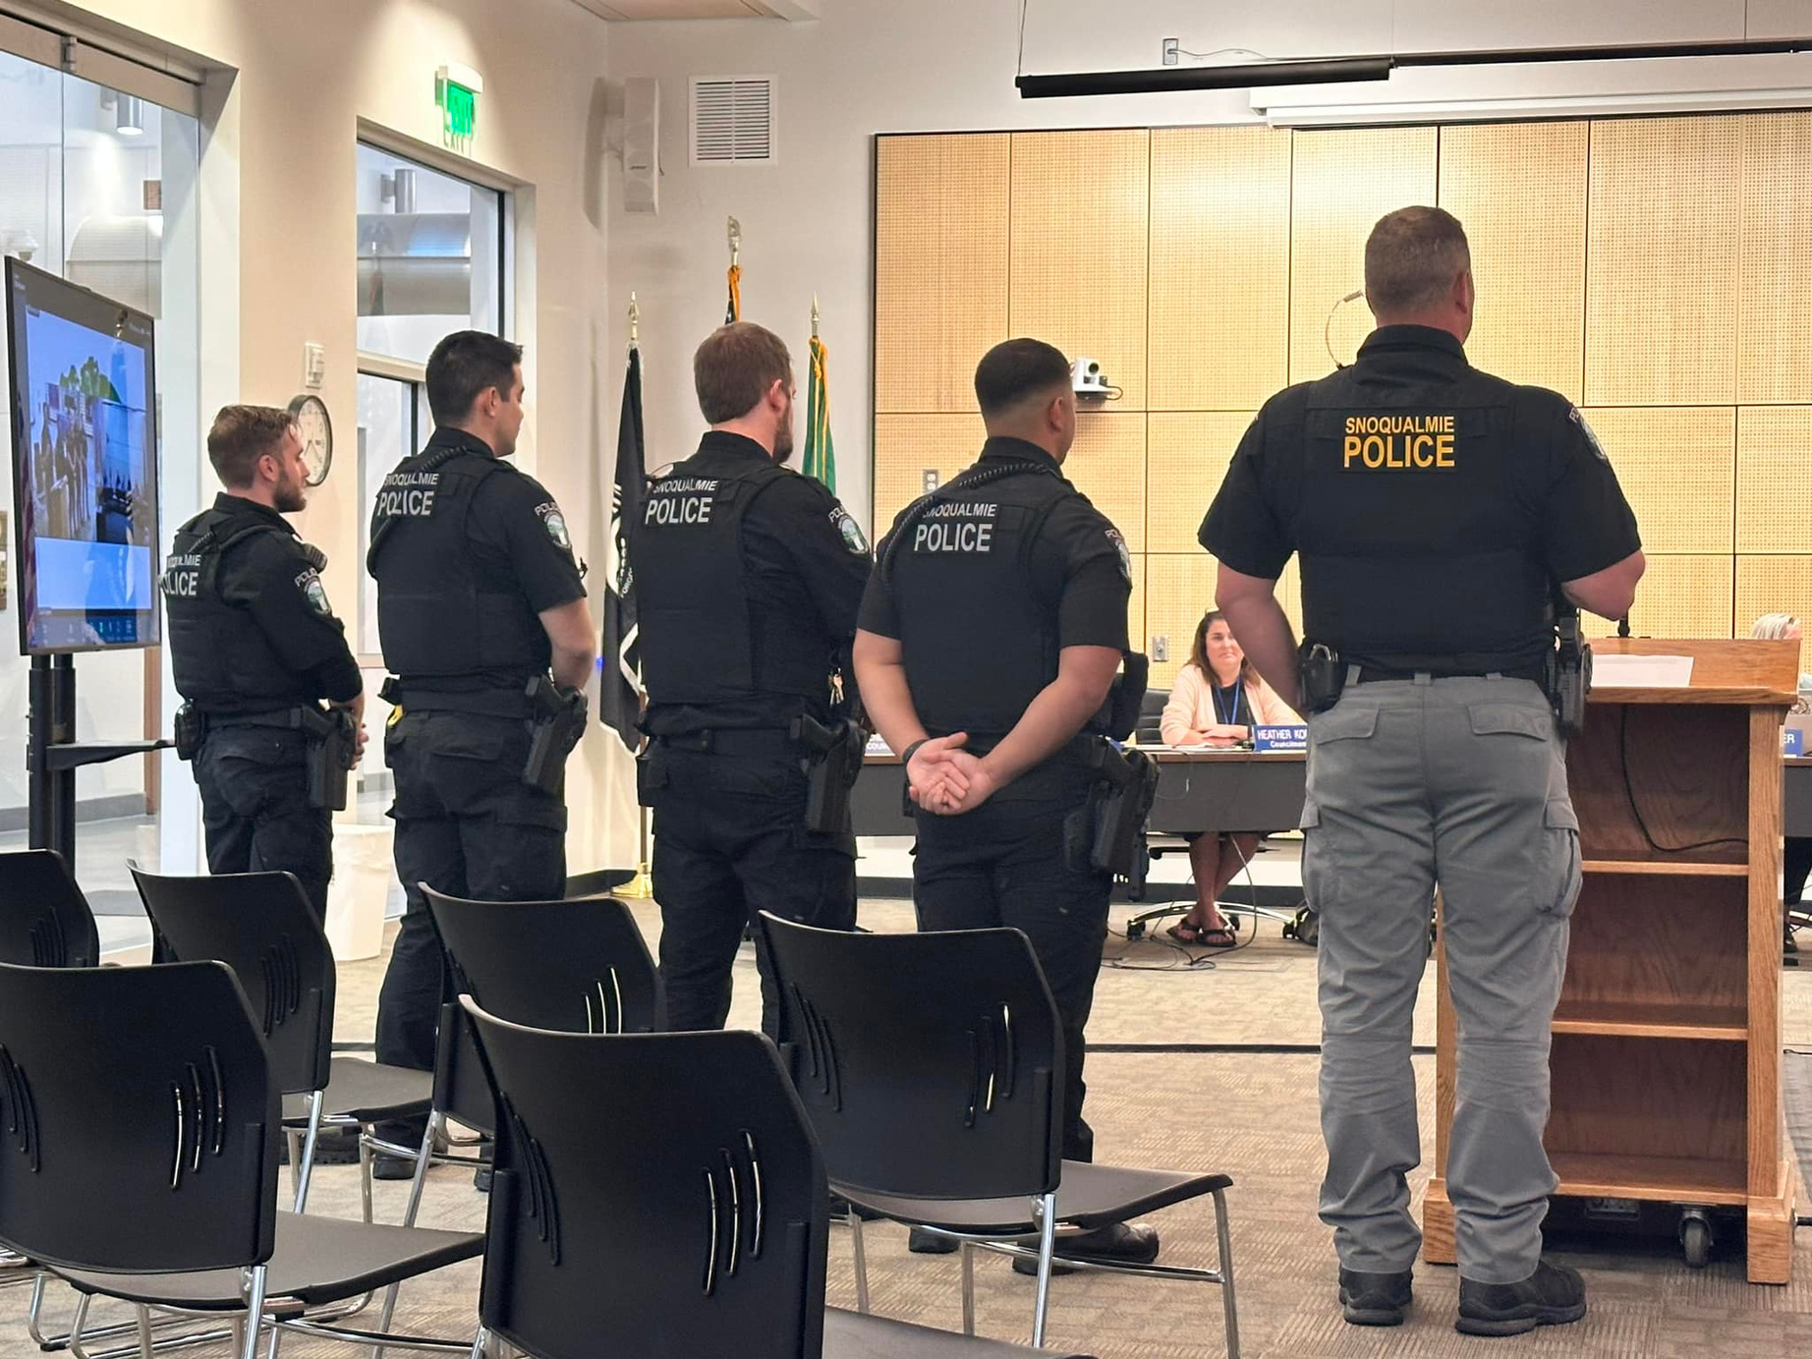


JOINT ADVISORY COMMITTEE
A SHARED PUBLIC SAFETY VISION
Snoqualmie Police Advisory Committee (SNOPAC)
  Quarterly Meeting with Council Members
  Discussion of Operations, Staffing, Incidents, Statistical Information, and Budgets
  Advice on Direction
  Open to the Public
  Annual Reports
Snoqualmie Police Technical Working Group (SNOTEC)
  Staff Representatives
  Discussion of Operations, Staffing, and Budgets
  Quarterly Reports
    Statistics
    Average Response Times
    Year-to-Date Budget-to-Actuals
    Human Resources
      Vacancies
      Recruitment
      Union Matters

Slide 24
SECTION
6
COST

Slide 25
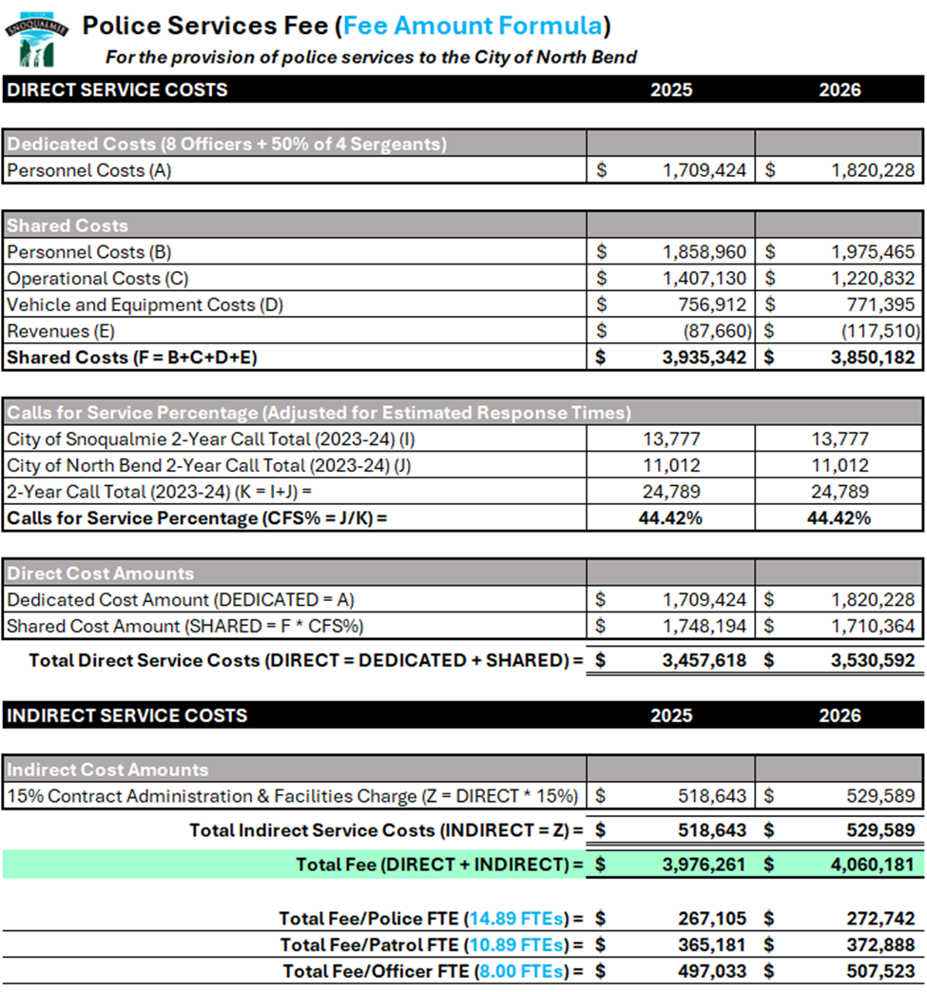
POLICE SERVICES FEE
FEE AMOUNT FORMULA
Cost Reconciliation
  Matching the payment to the actual cost of providing services.
Cost Control
  “Cops, cars, and contracts.”
  Limit in the increase of operational costs to the June-to-June biennial change in the CPI-W.
Contract Administration & Facilities Charge
  A flat 15% charge.
  Admin: HR (Recruitment), Finance (Payroll, AP, etc.), IT (hardware, software), Insurance, and Leadership.
  Facilities: Office space for staff, interview rooms, safe storage for evidence, holding cells for detainees, training rooms (including a fully equipped gun range).

Slide 26
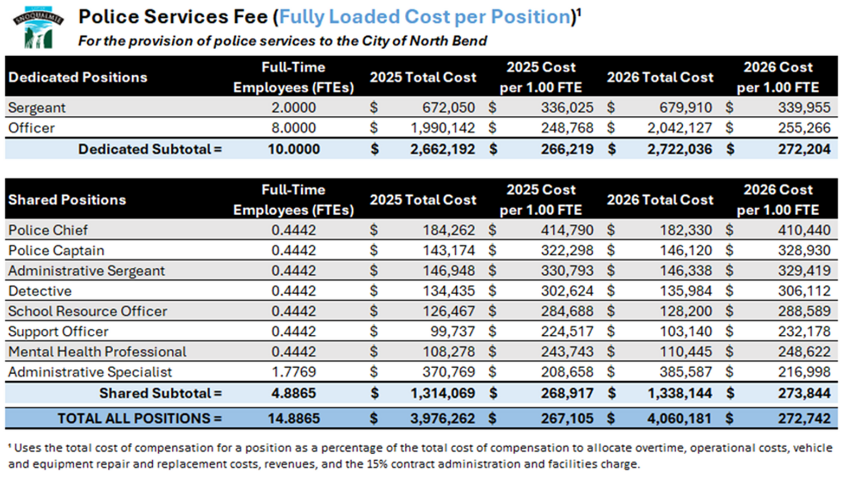
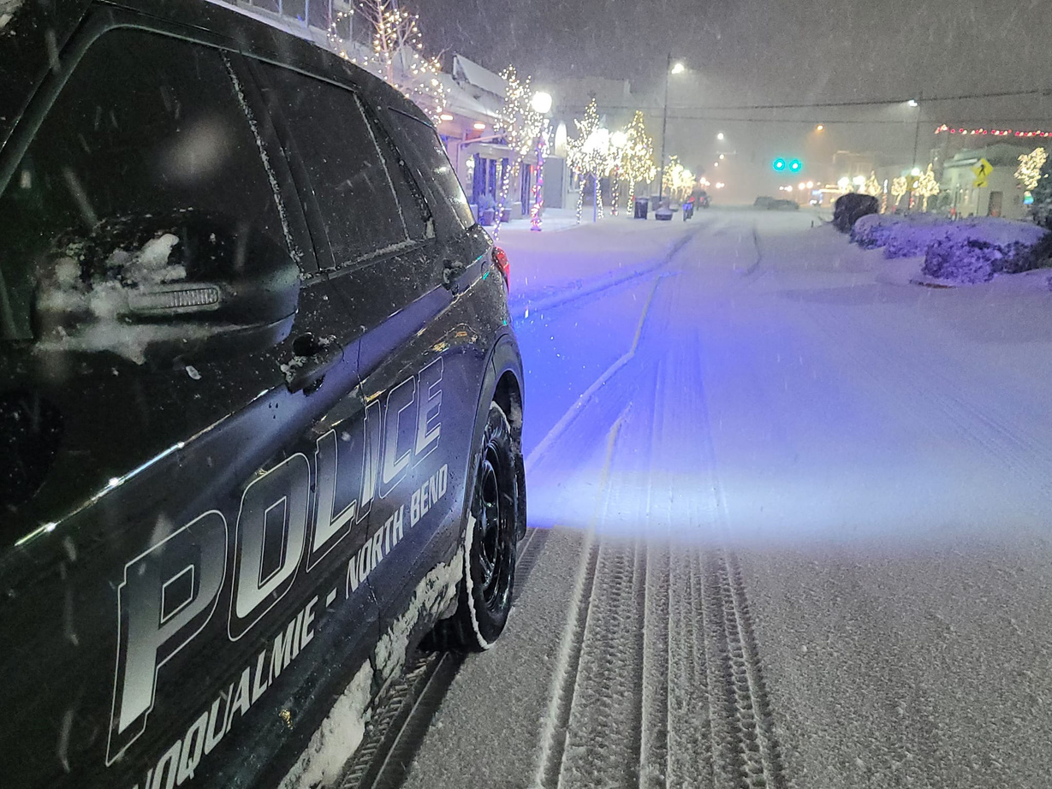
POLICE SERVICES FEE
FULLY LOADED COST PER POSITION

Slide 27
SECTION
7
CONTACTS

Slide 28

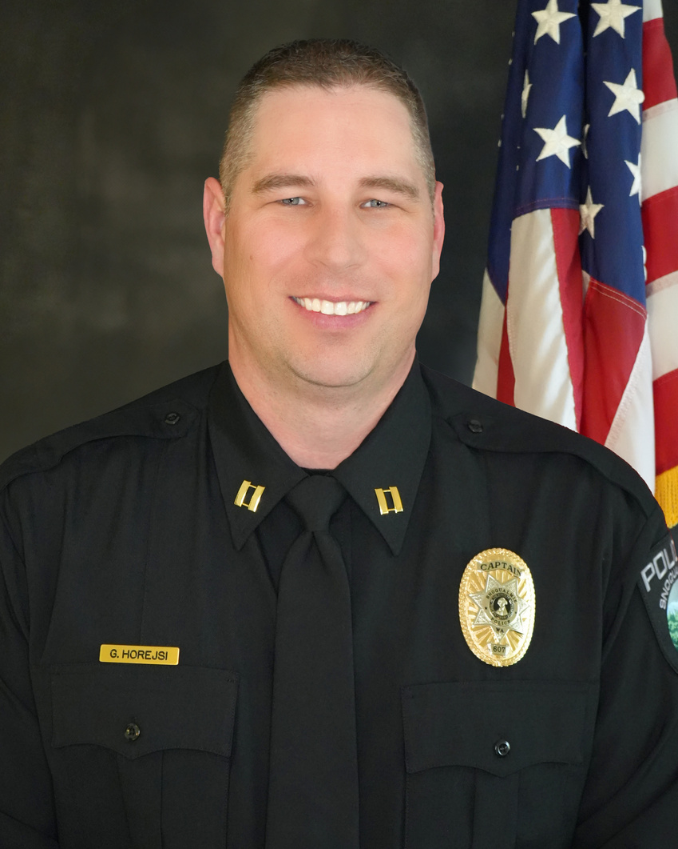


OUR TEAM
Gary
Horejsi
Drew
Bouta
Police Captain
Finance Director
ghorejsi@snoqualmiewa.gov
dbouta@snoqualmiewa.gov
425-507-8215
425-996-5445

